Slide 1
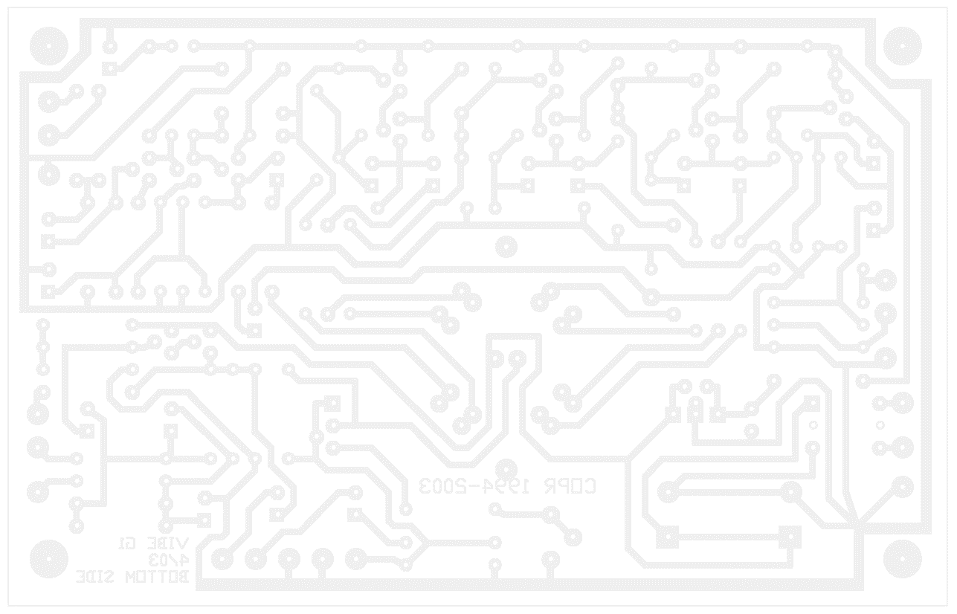

Wireless Energy Monitor

Slide 2
Introduction
Our objective is to calculate the peak current, RMS voltage and power of a input source and to display it on a device.
How do we implement?
By the use of a Wireless energy monitor
Reasons for project:
The world is decreasing in fossil fuels thus we have limited electrical power generation.
Therefore to limit consumption, energy monitors are used to collect data and display it in a useful manner.

Slide 3
Specifications of Design
Input Specifications
Source Characteristics → 12 to 14V_{RMS} at 500Hz +- 10%
Maximum load → 8.5VA
Output Specifications
Must display on a 7 Segment display the values calculated
Single LED light with different blink rates
1 blink per second if power is less than 25%
2 blinks per second if power between 25% and 50%
3 blinks if power between 50% and 75%
Solid LED signal if power over 75% (max is 100%)
Must display Vrms, Peak current and power.

Slide 4
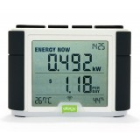
Existing products
OWL+USB energy monitor
Manufacturer : OWL®
Measures the cost per watt as well as energy consumption
Easy to install into the house’s power frame
Displays greenhouse gas impact
Operating frequency 433MHz
Large battery life
Operating range of 30 metres
12 second refresh rate of data
Efergy Energy Monitor
Manufacturer : Efergy
Up to 70 metre range
6 Second refresh rate of data.
Ergonomic Design
Operating frequency of RF module 433MHz
Sensor Voltage Range between 110V and 400V
Measuring Current 50mA – 120A
64k Memory
Watts Clever, EW4500
Manufacturer : Watts Clever
Up to 80 metre range
30 Second refresh rate of data.
Compatible with all voltages
Operating frequency of RF module 433MHz
LCD display
Displays historical usage for a custom period of time (24 hrs, 7days or 4 months)

Slide 5
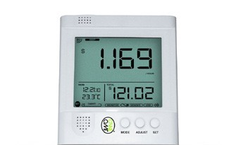
Comparison
Group 14 Design
Single Phase Compatible – Can receive a single phase AC source as input
Outputs on a 7 Segment Display the Power, Peak Current and RMS Voltage of source.
Requires the use of one power source – The AC input, used for other electronics inside such as opamps.
Wirelessly monitored
OWL+USB Energy Monitor
Single Phase compatible
Three Phase compatible
Custom LCD panel
Outputs energy usage and cost (price per watt).
Display module powered by 3 AA Batteries

Slide 6
Analog Design

Slide 7
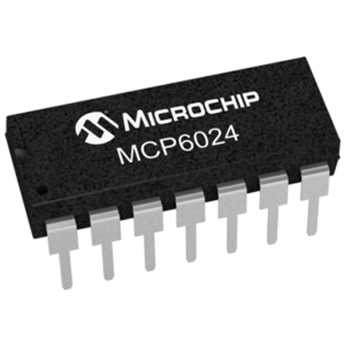
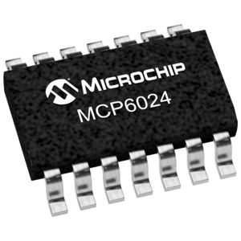
Microchip MCP6024
10MHz Gain bandwidth
2.5V to 5.5V Power supply range:
Thin-Shrink small outline package (TSSOP) or Plastic Dual-in-line Package (PDIP
Slew rate of 7V/µs
Input bias current of 1pA
CMRR: 90dB
$2USD each

Slide 8
Linear Technology LTC6088
14MHz Gain bandwidth
2.7V to 5.5V Operation voltage
Shrink small outline package (SSOP)
Slew rate of 7.2V/µs
Input bias current: 1pA at 25 °C and 15pA at 85 °C
CMRR: 80dB
$2USD each

Slide 9
Schematic

Slide 10
Microcontroller
UART Transmitter

Slide 11
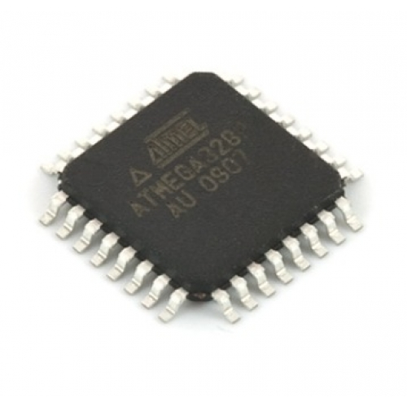
Atmel ATmega328P
8 Channel 10-bit ADC
USART
Low power (3.3V)
16MHz system clock
Simple instruction set (RISC)
131 Instructions
Interrupts & Timers
$9.78USD

Slide 12
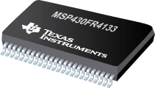
Texas Instruments MSP430FR4133
Features:
Ultra-Low-Power
UART
16MHz System Clock
10 Channel 10-bit ADC
16KB FRAM (Ferroelectric RAM)
2KB SRAM
16-Bit RISC Architecture
$14USD
IDE:
Code Composer Studio or IAR Embedded Workbench
Development Language:
C

Slide 13
C Flowchart
START
Set UCSRC to set asynchronous mode, data frame size, parity and stop bit
Set UBRR to the required baud rate with selected frequency
Set UCSRB to enable UART transmit
NO
Check if UDR empty.
UDRE == 0;
Transmit Character
YES
Prepare data (character) for transmission
YES
Need to transmit another character?
NO
END

Slide 14
CPLD Design
UART Receiver

Slide 15
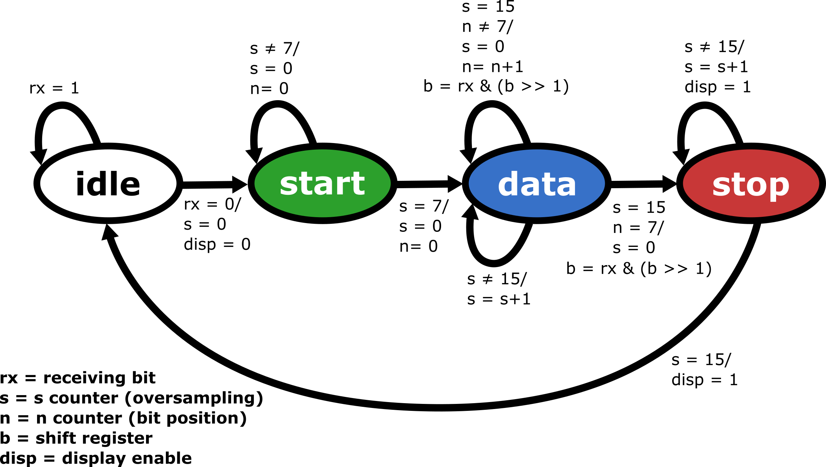
FSM Implementation (Mealy)

Slide 16
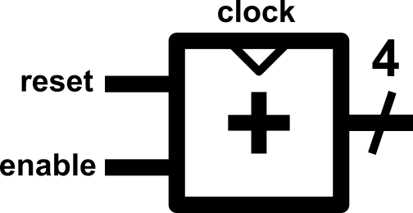
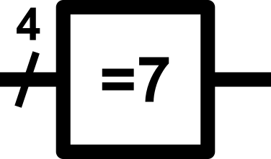
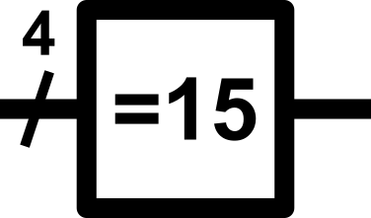
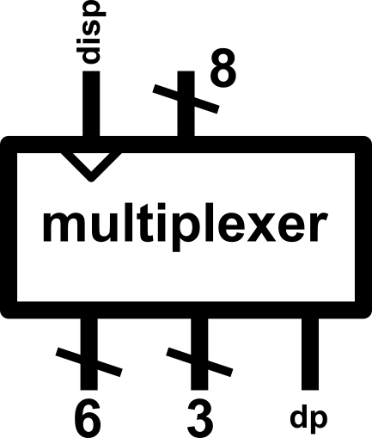
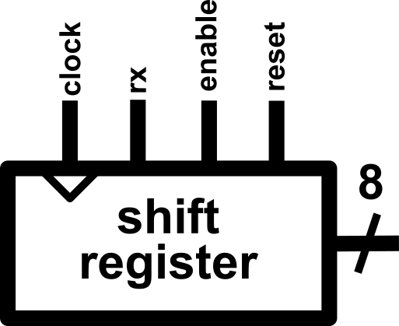
CPLD Datapath Components
Two 4-bit counters
Two 4-bit comparators (for 7)
One 4-bit comparator (for 15)
One 8-bit shift register
One 8-bit multiplexer with enable

Slide 17
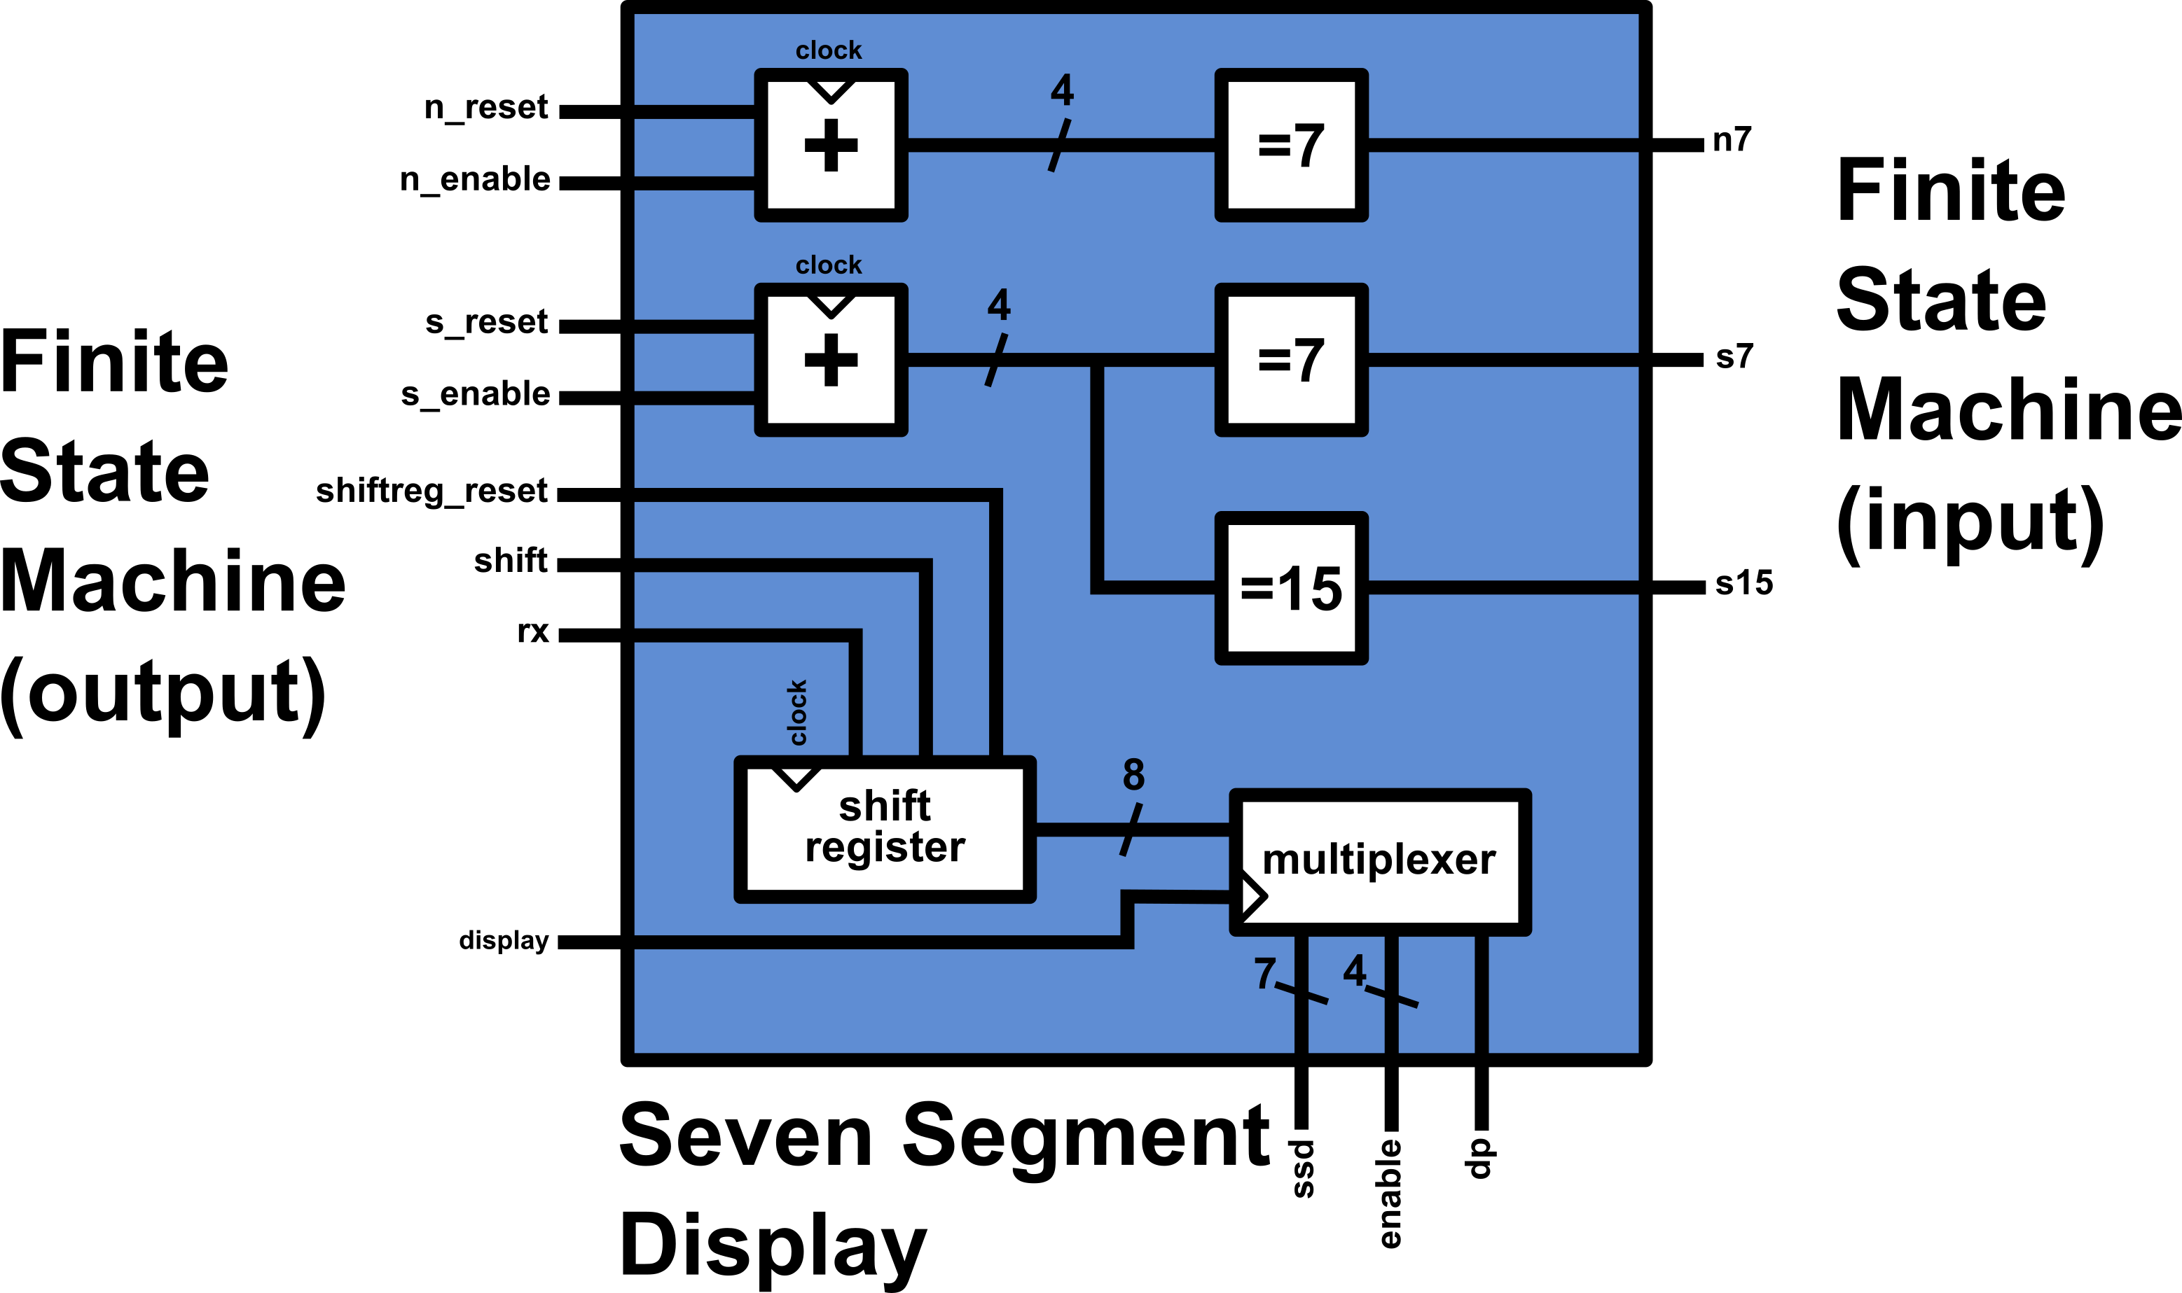
CPLD Datapath

Slide 18
Design Challenges
Multiplexer lacks control and streams data from shift register
A clocked output from FSM to Multiplexer is used to verify that the output is valid
Transmission method is asynchronous, no parity
Framing error: depending on time of start up, can take any 1 0 sequence as start of transmission
Solution: initiate UART transmission with a longer idle state (1) or transmit additional packet of (“11111111”)

Slide 19
Smart Energy
Stage 1: Implement desktop connectivity via Serial-to-USB.
Matlab
Alternatives: RealtimePlotter, Bridge Control Panel
Stage 2: Add price per watt data
Stage 3: Implement wi-fi connectivity to an IoT service
Thingspeak
Alternatives: Private server, data.sparkfun.com + analog.io

